Slide 1
Development of MRI T2* Mapping Model for N-Periodic ka-SPGR Sequence:
A Promising Technique for Parkinson’s Disease Biomarker Detection
MEng Individual Project Presentation
Yifei Jin

Slide 2
Development of MRI T2* Mapping Model for N-Periodic ka-SPGR Sequence:
A Promising Technique for Parkinson’s Disease Biomarker Detection
Overview…
Background introduction
Theory
N-periodic ka-SPGR
Computer simulation
Method
Result
Practical MRI scan
Method
Result
Conclusion and Limitations
Q & A

Slide 3
Development of MRI T2* Mapping Model for N-Periodic ka-SPGR Sequence:
A Promising Technique for Parkinson’s Disease Biomarker Detection
Overview…
Background introduction
Theory
N-periodic ka-SPGR
Computer simulation
Method
Result
Practical MRI scan
Method
Result
Conclusion and Limitations
Q & A

Slide 4
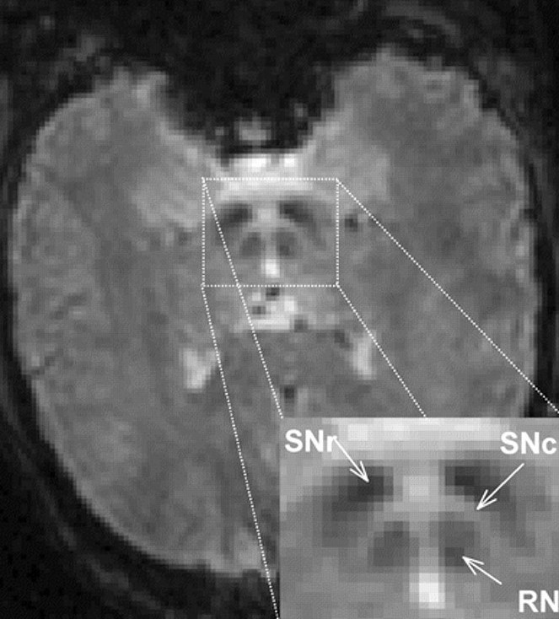
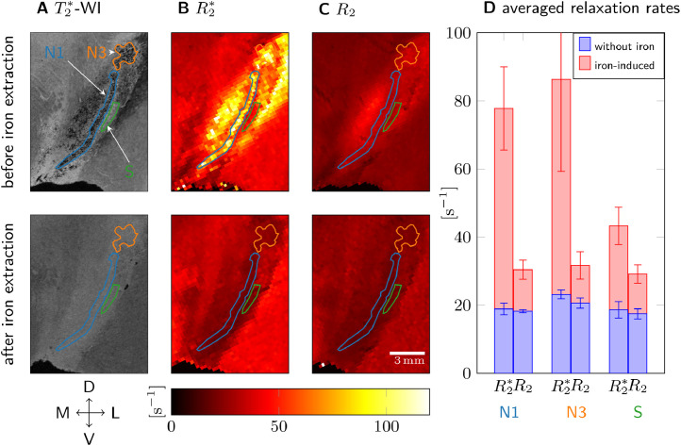
Background introduction
Parkinson’s Disease
MRI time constant T2* as an effective biomarker
Brammerloh, Malte et al.(2021) [1]
Healthy control T2* | PD patient T2*
53 ms | 13 ms
R2*
Excess iron at substantia nigra
Quantitative R2* images of SN
Notes:
Parkinson’s Disease Early detection → aid treatment development & tracks disease development
Excessive iron at SN, midbrain
T2*, tissue and field inhomogeneities dependent time constant
An effective biomarker.
How we get the time constant

Slide 5
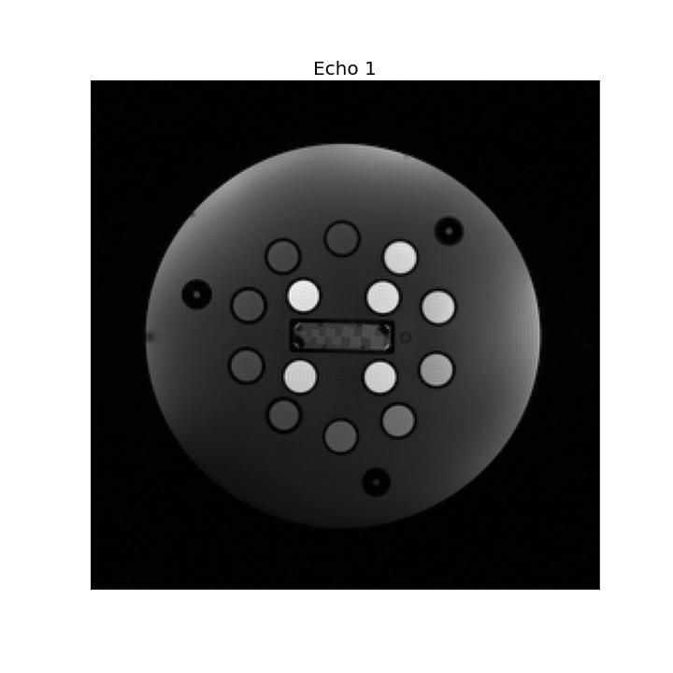
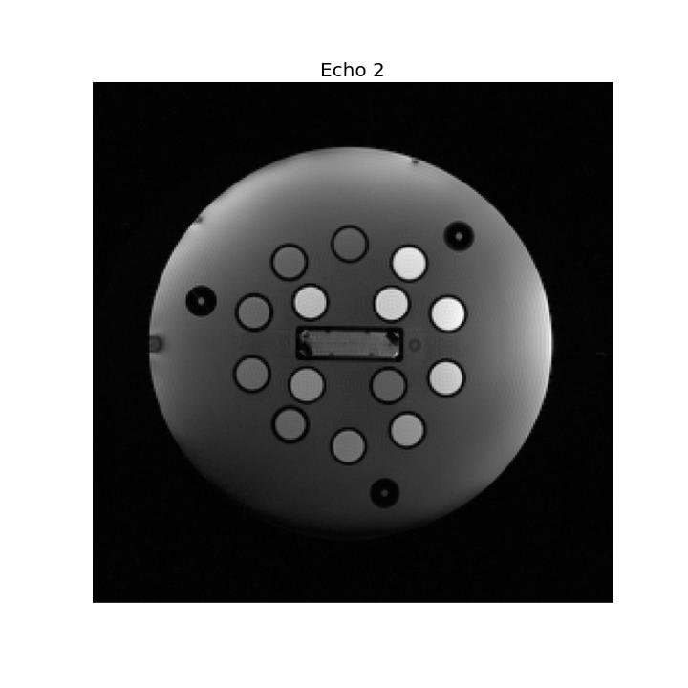
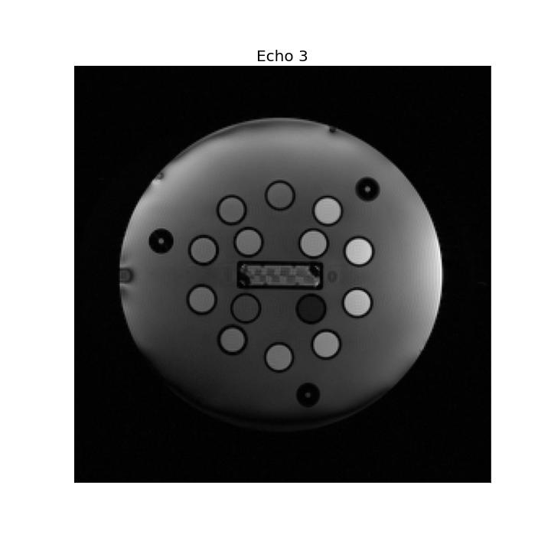
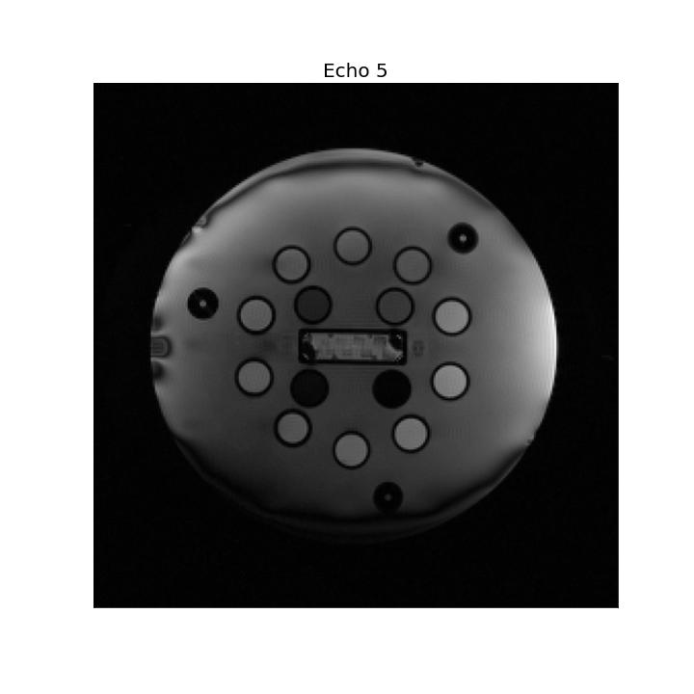
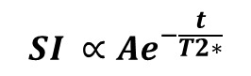
Background introduction
What is T2*?
Gold-standard T2* mapping technique
$$SI ∝Ae^{−\frac{t}{T2∗}}$$
Multi-echo spoiled gradient recall
(multi-echo SPGR)
repeat…
Signal Intensity (SI)
TE = a
Time
TE = b
TE = b
TE = a
Notes:
MRI signal, brief
TE, TR
Signal decay with T2*
Multiple acquisitions, at different TE

Slide 6
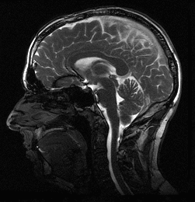
Background introduction
What is T2*?
Gold-standard T2* mapping technique
$$SI ∝Ae^{−\frac{t}{T2∗}}$$
Multi-echo spoiled gradient recall
(multi-echo SPGR)
repeat…
Signal Intensity (SI)
TE = a
Time
TE = b
TE = b
TE = a
Motion artefact
Possible solution:
N-periodic ka-SPGR
Notes:
The problem, motion artefact → cerebellum fluid flow, cardiac cycle
Not directly getting the decayed signal, build the signal using component from each acquisition.

Slide 7
Development of MRI T2* Mapping Model for N-Periodic ka-SPGR Sequence:
A Promising Technique for Parkinson’s Disease Biomarker Detection
Overview…
Background introduction
Theory
N-periodic ka-SPGR
Computer simulation
Method
Result
Practical MRI scan
Method
Result
Conclusion and Limitations
Q & A

Slide 8
Theory
N-periodic ka-SPGR

Slide 9
Development of MRI T2* Mapping Model for N-Periodic ka-SPGR Sequence:
A Promising Technique for Parkinson’s Disease Biomarker Detection
Overview…
Background introduction
Theory
N-periodic ka-SPGR
Computer simulation
Method
Result
Practical MRI scan
Method
Result
Conclusion and Limitations
Q & A

Slide 10
Computer Simulation
Method

Slide 11
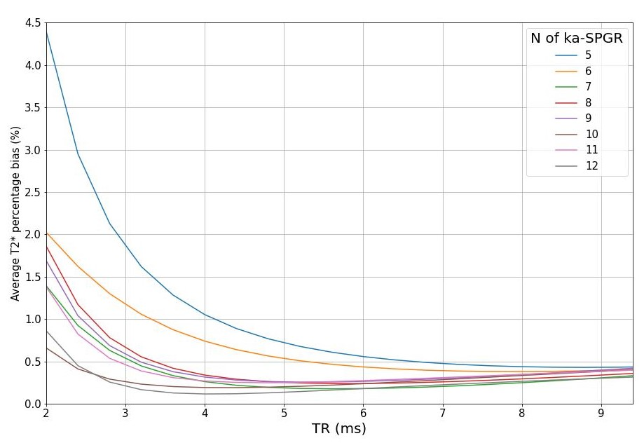
Computer Simulation
Result
Average T2* percentage bias

Slide 12
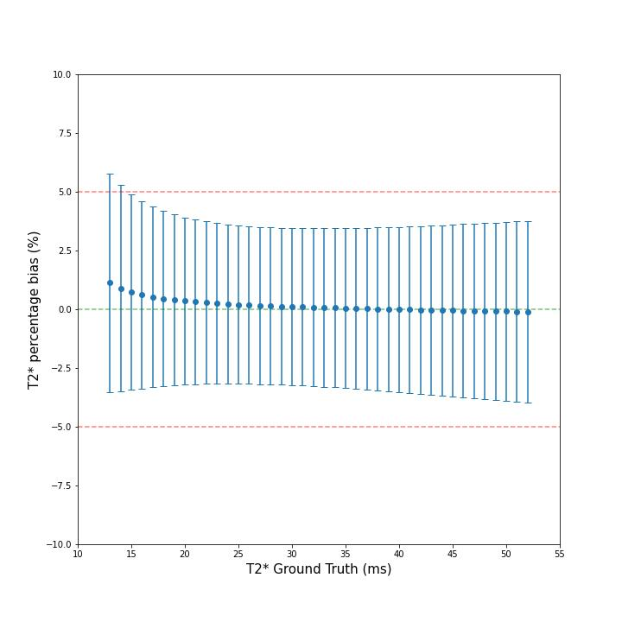
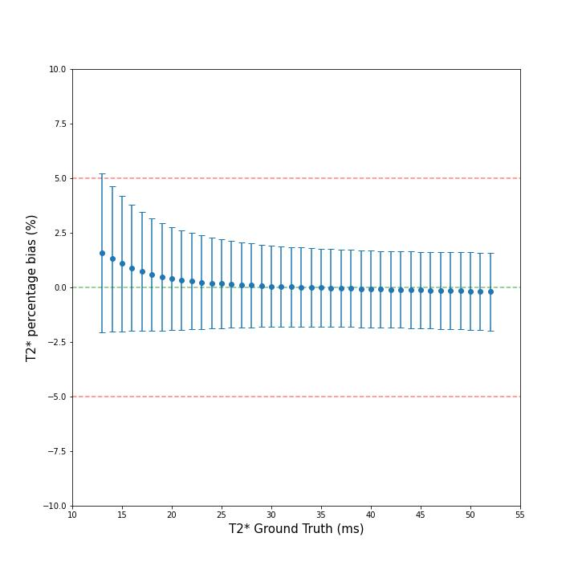
Computer Simulation
Result
Optimal ka-SPGR percentage bias and standard deviation
N = 7, TR = 6ms
N = 12, TR = 6ms

Slide 13
Development of MRI T2* Mapping Model for N-Periodic ka-SPGR Sequence:
A Promising Technique for Parkinson’s Disease Biomarker Detection
Overview…
Background introduction
Theory
N-periodic ka-SPGR
Computer simulation
Method
Result
Practical MRI scan
Method
Result
Conclusion and Limitations
Q & A

Slide 14
Practical MRI Scan
Method

Slide 15
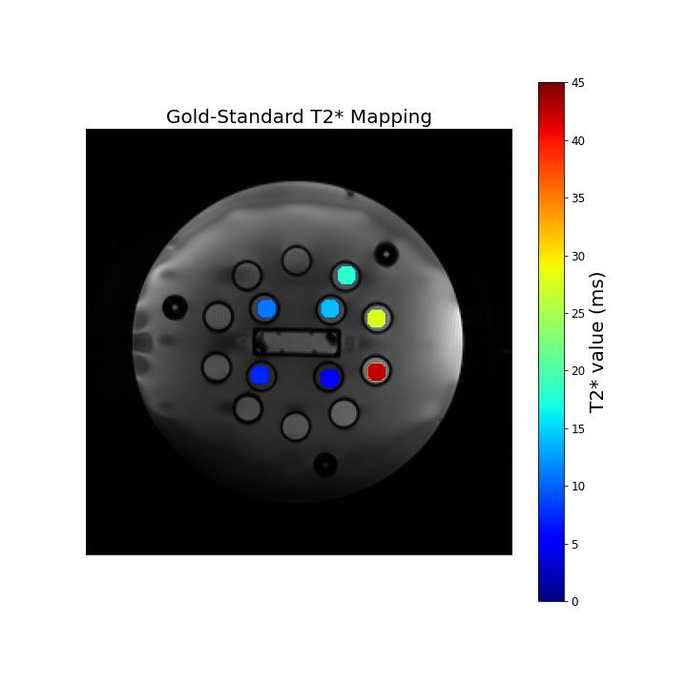
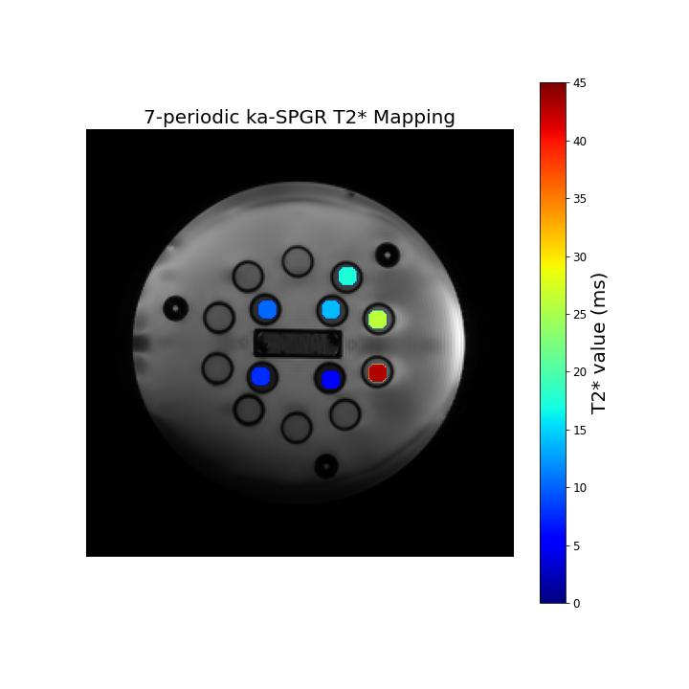

Practical MRI Scan
Result
Quantitative T2* mapping images
Gold-standard
7-periodic ka-SPGR
12-periodic ka-SPGR
Notes:
Percentage error, middle line zero bias, red line +-10%
12 periodic has smaller std
All within +-10% bias
Effective T2* SNR
→ 7 periodic more efficient at low T2*

Slide 16
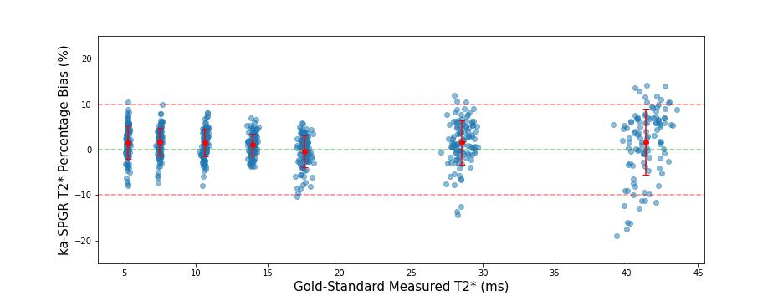
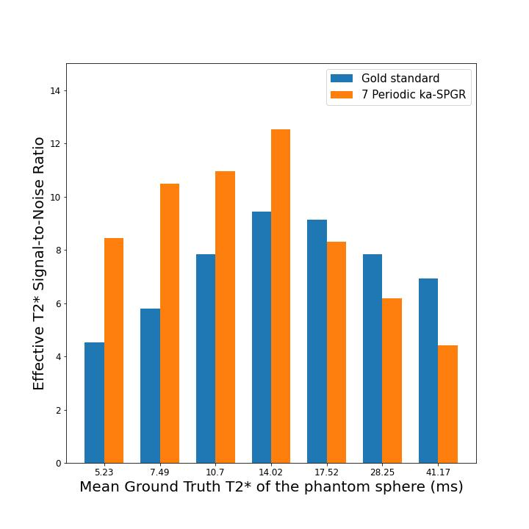
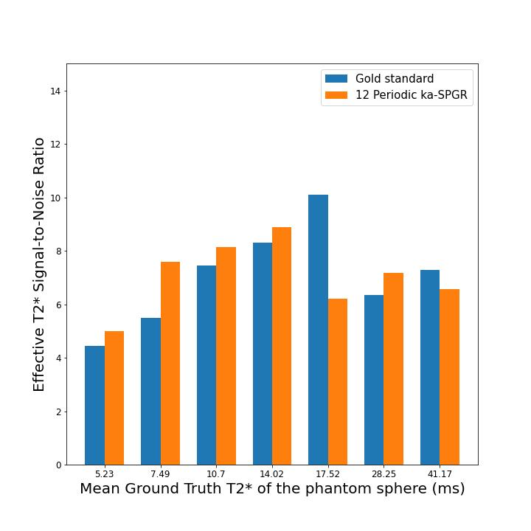
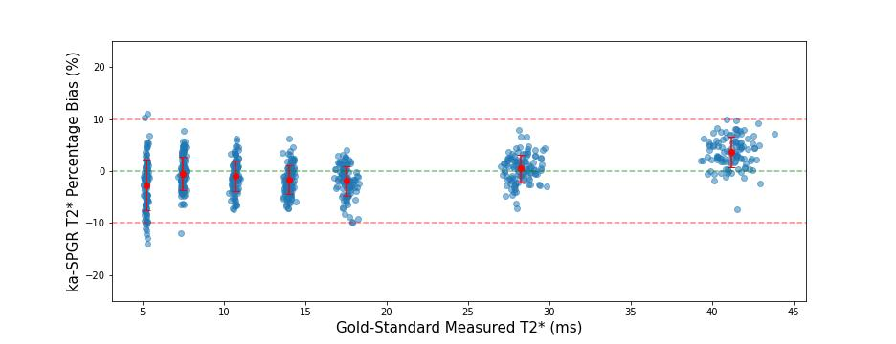
Practical MRI Scan
Result
T2* percentage error
Effective T2* SNR
N = 7
N = 12
Notes:
Percentage error, middle line zero bias, red line +-10%
12 periodic has smaller std
All within +-10% bias
Effective T2* SNR
→ 7 periodic more efficient at low T2*

Slide 17
Development of MRI T2* Mapping Model for N-Periodic ka-SPGR Sequence:
A Promising Technique for Parkinson’s Disease Biomarker Detection
Overview…
Background introduction
Theory
N-periodic ka-SPGR
Computer simulation
Method
Result
Practical MRI scan
Method
Result
Conclusion and Limitations
Q & A

Slide 18
Conclusion
Conclusion
Optimal ka-SPGR:
7-periodic ka-SPGR TR = 6ms
12-periodic ka-SPGR TR = 6ms
7-periodic is more efficient for PD detection.
12-periodic is more precise.

Slide 19
Limitation and Further
Limitation
Phantom misalign with substantia nigra tissue property (T1).
Large amounts of in vivo scan experiments are required to statistically prove the method for clinical use.
Further
The optimal parameters can be used to test motion robustness in vivo.

Slide 20
References:
References
Brammerloh, M., Morawski, M., Friedrich, I., Reinert, T., Lange, C., Pelicon, P., Vavpetič, P., Jankuhn, S., Jäger, C., Alkemade, A., Balesar, R., Pine, K., Gavriilidis, F., Trampel, R., Reimer, E., Arendt, T., Weiskopf, N., & Kirilina, E. (2021). Measuring the iron content of dopaminergic neurons in substantia nigra with MRI relaxometry. NeuroImage, 239. https://doi.org/10.1016/j.neuroimage.2021.118255
Holdsworth, S. J., Rahimi, M. S., Ni, W. W., Zaharchuk, G., & Moseley, M. E. (2016). Amplified magnetic resonance imaging (aMRI). Magnetic Resonance in Medicine, 75(6), 2245–2254. https://doi.org/10.1002/mrm.26142
Lally, P. J., Chiew, M., Matthews, P. M., Miller, K. L., & Bangerter, N. K. (n.d.). A motion-robust, short-TR alternative to multi-echo SPGR.

